Slide 1
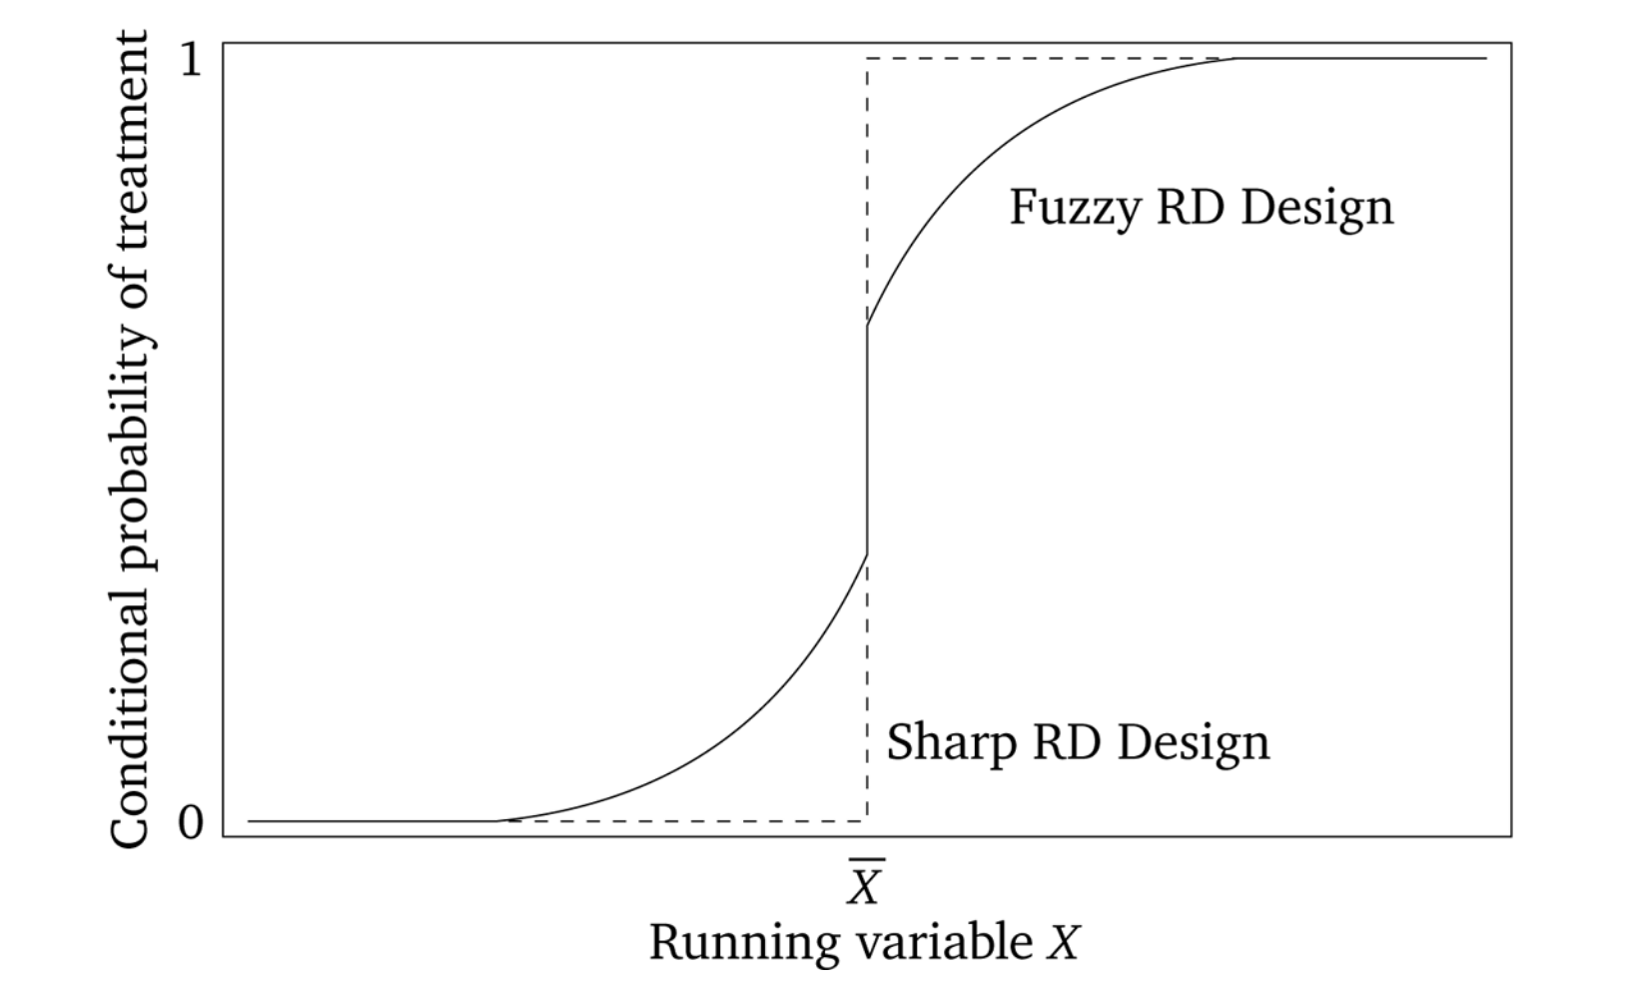
REGRESSION DISCONTINUITY I
Figure 6.4. from Cunningham (2021)
José Manuel Arencibia Alemán
Session 8

Slide 2
5 | Fixed Effects Time: 30 August 2022, 12:15-14:00h Main instructor: José Manuel Arencibia Alemán Required reading: Huntington-Klein (2022), chapter 16
6 | Fixed Effects / Instrumental Variables Time: 2 September 2022, 10:15-12:00h Main instructor: José Manuel Arencibia Alemán Required reading: H-K (2022), chapter 16; A. & P., chapter 3
7 | Instrumental Variables Time: 6 September 2022, 12:15-14:00h Main instructor: José Manuel Arencibia Alemán Required reading: Angrist & Pischke (2015), chapter 3
8 | Regression Discontinuity I Time: 9 September 2022, 10:15-12:00h Main instructor: José Manuel Arencibia Alemán Required reading: Angrist & Pischke (2015), chapter 4

Slide 3

Last session’s take-away messages
IV allow us to draw causal inferences when treatment is endogenous
Good instruments (relevant, independent and satisfying the exclusion restriction) are hard to find.
External validity of LATEs should be well argued for, specially if instruments are “naturally occurring”.

Slide 4
Session’s learning goal
Understanding the role of rules in generating “as good as random” circumstances to infer causal effects
Getting the intuition of RD Designs through analysis of DAGs and graphs, and being able to formalize simple specifications

Slide 5

Content
Introduction
Rules on chance
Four elements of RDD
Birthdays and Funerals
Sharp RD
RD Formalization
Parametric and Non-parametric RD
The Elite Illusion
Fuzzy RD
Fuzzy RD Is IV
Photo by Taneli Lahtinen on Unsplash
Notes:
INTRODUCTION: we start contextualizing the method. Some examples are given that may be hard to understand but are classics illustrating the power of RDD. You will understand them better by the end of class.
SHARP AND FUZZY (The Effect, 2022): cut off is the only dterminant of treatment (sharp). Often this isn’t the case. In a lot of regression dicontinuity application, being on one side or another of the cutoff only changes the probability of treatment. In these cases we have what’s called a fuzzy regression discontinuity, as opposed to a sharp regression discontinuity where treatment rates jump from 0% to 100%. Figure 20.3

Slide 6
Introduction
One of the main challenges (if not “the main challenge”) of Social Sciences is to deal with the vast amount of variables potentially confounding (causal) relations of interest
To study these (causal) relations, the gold standard is the RCT for its ability to isolate treatment effects from those of confounders
Control strategies may eliminate the confounding effect of observable variables, and IV isolate causal paths exploiting naturally occurring or researcher induced partial randomization.
In this session, we introduce another potentially powerful tool in our quest to find causal effects
Regression Discontinuity Designs: Rules on chance
”Human behavior is constrained by rules. [e.g., on class size, age of retirement, recruitment] Although many of these rules seem arbitrary, we say: bring ‘em on!
For rules that constrain the role of chance in human affairs often generate interesting experiments.”
Angrist and Pischke (2015, p. 147)

Slide 7
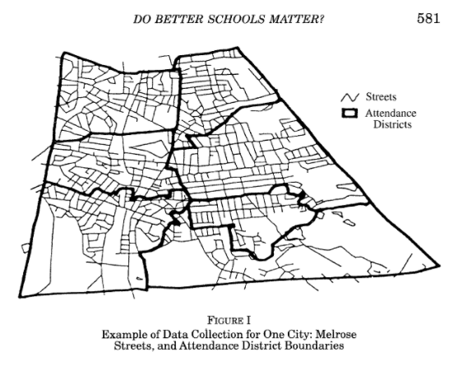
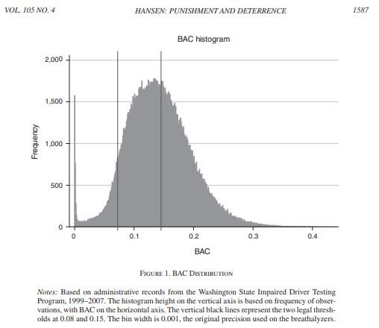
Introduction
The deterministic and, often times, arbitrary nature of rules provides opportunities to answer causal questions otherwise impossible to explore, e.g.,
How much more are parents willing to pay for better schools? (Black, 1999)
In district boundaries, the only difference in the value of a house might be determined by where a child is mandated to attend. Finds that parents are willing to pay 2,5% more for a 5% increase in test scores.
What is the effect of punishment on drinking and driving recidivism? (Hansen, 2015)
Different levels of alcohol in blood are associated with different punishment. Finds that fines reduce recidivism in 2 percent points (-17%) and jail in 1 additional point (-9%).
Cunningham (2021)
Notes:
Black(1999) look within school districts at houses located on attendance district boundaries; houses then differ only by the elementary school the child attends. Thereby removing variation in neighborhoods, taxes, and school spending. Finds that parents are willing to pay 2,5 percent more for a 5 percent increase in test scores.
Hansen (2015) Regression discontinuity derived estimates suggest that having a blood alcohol content (BAC) above the driving under the influence (DUI) threshold reduces recidivism by up to 2 percentage points (17 percent). Likewise having a BAC over the aggravated DUI threshold reduces recidivism by an additional percentage point (9 percent).

Slide 8
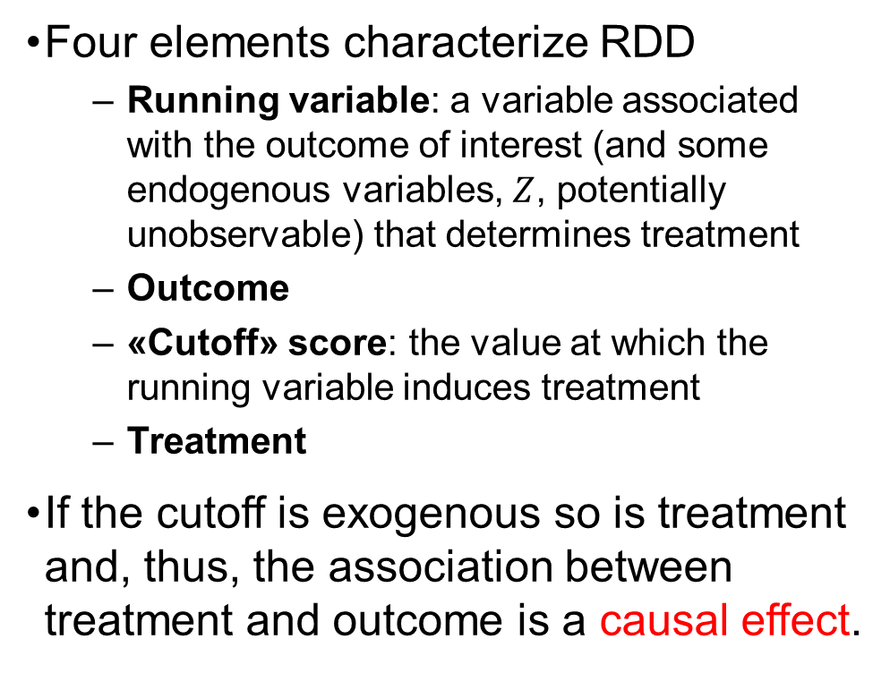
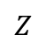
Introduction
RDD: The Intuition
Four elements characterize RDD
Running variable: a variable associated with the outcome of interest (and some endogenous variables, $Z$, potentially unobservable) that determines treatment
Outcome
«Cutoff» score: the value at which the running variable induces treatment
Treatment
If the cutoff is exogenous so is treatment and, thus, the association between treatment and outcome is a causal effect.
Running variable
$$Z$$
Cutoff
Treatment
Outcome
Huntington (2022)

Slide 9
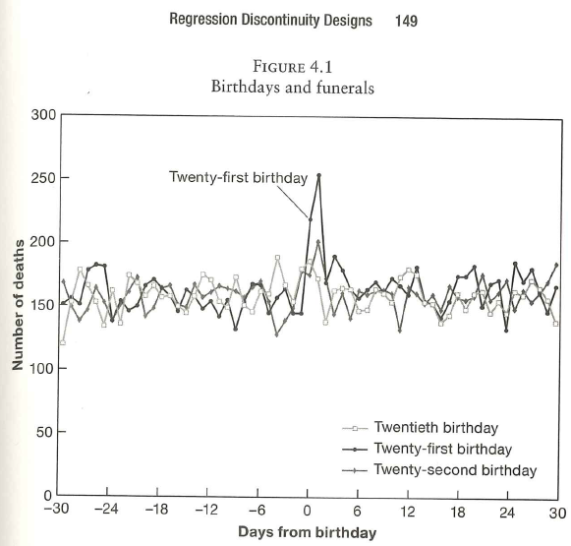
Birthdays and Funerals
What does figure 4.1 suggest?
Setting the Stage
Despite a Minimum Legal Drink Age (MLDA) of 21-years-old, underage drinking is common and not necessarily moderate
A group of American Colleges presidents have lobbied to return to the Vietnam-era threshold of 18
Hypothesis: Lowering the legal drinking age, “would discourage binge drinking and promote a culture of mature alcohol consumption”
Alternative hypothesis: “age-21 reduces youth access to alcohol, thereby preventing some harm”
Angrist & Pischke (2015)

Slide 10
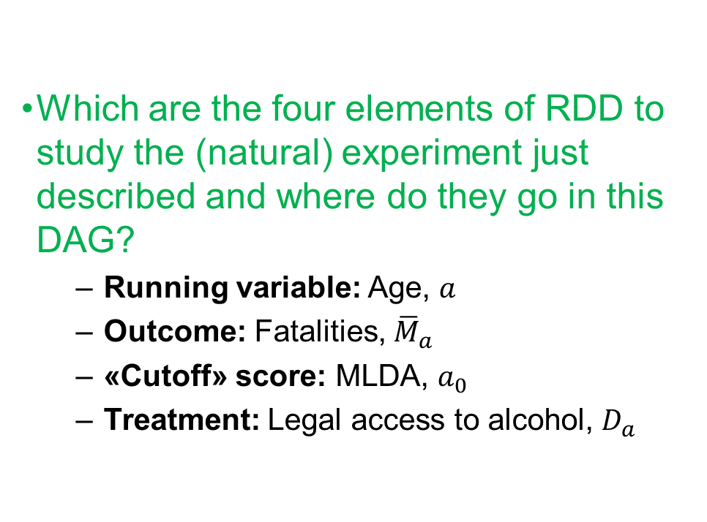
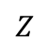
Birthdays and Funerals
Setting the Stage
Which are the four elements of RDD to study the (natural) experiment just described and where do they go in this DAG?
Running variable: Age, $a$
Outcome: Fatalities, ${\overline{M}}_{a}$
«Cutoff» score: MLDA, $a_{0}$
Treatment: Legal access to alcohol, $D_{a}$
Age
$$Z$$
MLDV
Legal Access
Fatalities
Huntington (2022)

Slide 11
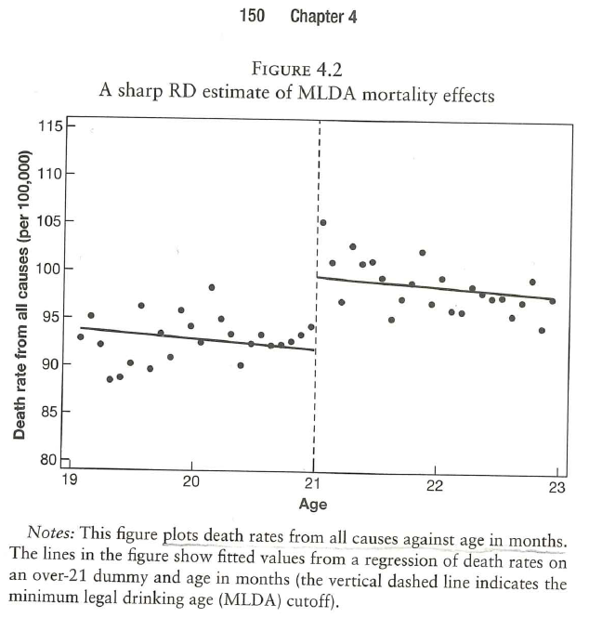
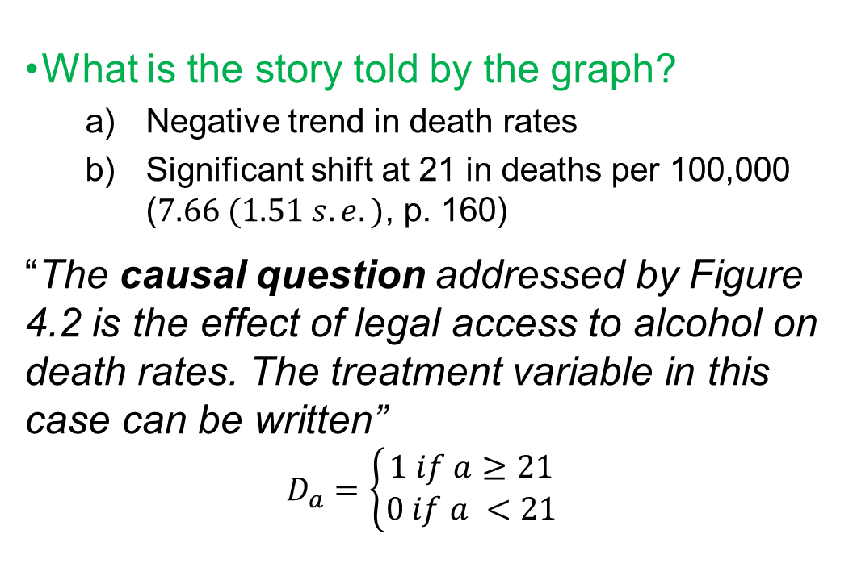
Birthdays and Funerals
Sharp RD
What is the story told by the graph?
Negative trend in death rates
Significant shift at 21 in deaths per 100,000 ($7.66 (1.51 s.e.)$, p. 160)
“The causal question addressed by Figure 4.2 is the effect of legal access to alcohol on death rates. The treatment variable in this case can be written”
$$D_{a}=\left\{\begin{aligned}1 if a≥21 \\ 0 if a <21\end{aligned}\right.$$
Angrist & Pischke (2015)

Slide 12
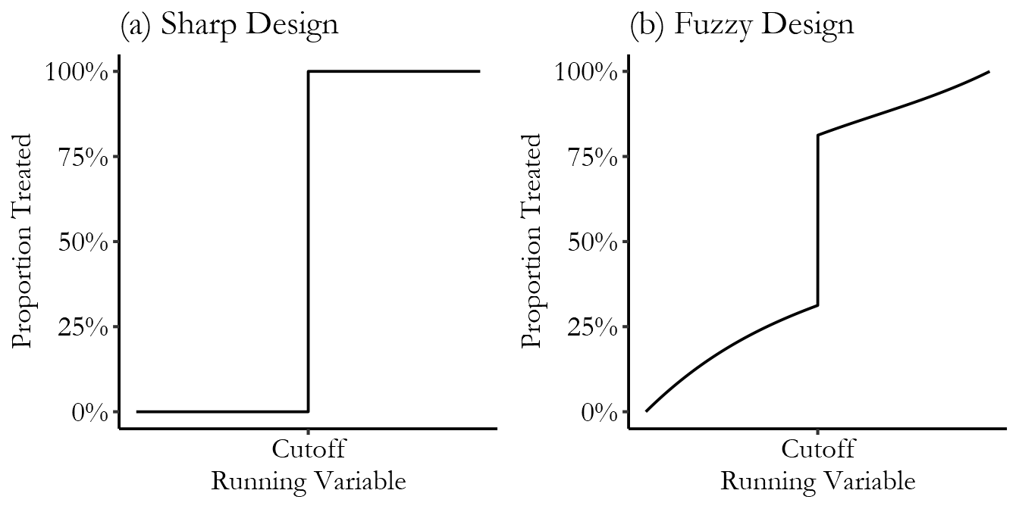
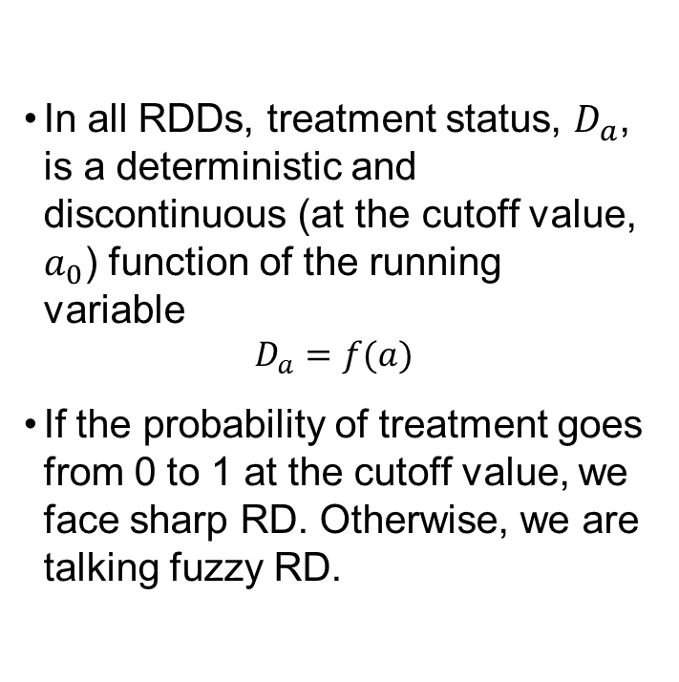
Birthdays and Funerals
Sharp RD
In all RDDs, treatment status, $D_{a}$, is a deterministic and discontinuous (at the cutoff value, $a_{0}$) function of the running variable
$$D_{a}=f(a)$$
If the probability of treatment goes from 0 to 1 at the cutoff value, we face sharp RD. Otherwise, we are talking fuzzy RD.
Figure 20.3 from Huntington (2022)
What kind of RD does generate the MLDV?

Slide 13
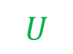
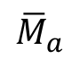
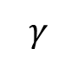
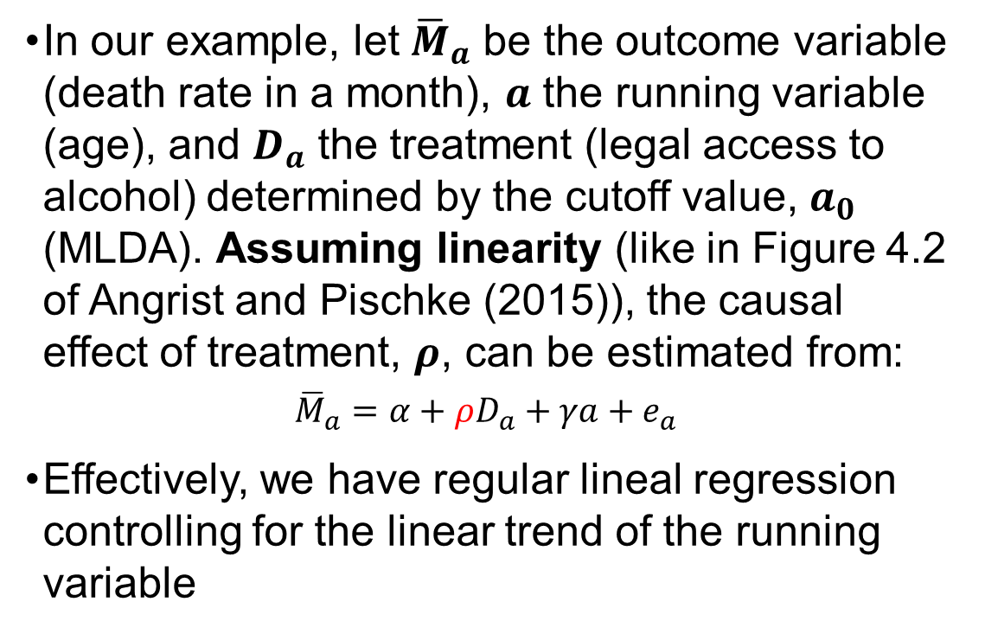
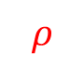
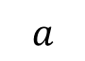
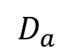
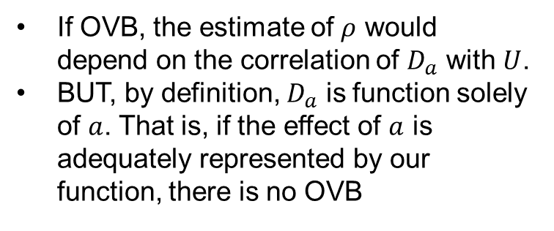
Birthdays and Funerals
RD Formalization: Linear trend
$$a$$
$$γ$$
In our example, let ${\overline{M}}_{a}$ be the outcome variable (death rate in a month), $a$ the running variable (age), and $D_{a}$ the treatment (legal access to alcohol) determined by the cutoff value, $a_{0}$ (MLDA). Assuming linearity (like in Figure 4.2 of Angrist and Pischke (2015)), the causal effect of treatment, $ρ$, can be estimated from:
$${\overline{M}}_{a}=α+ρD_{a}+γa+e_{a}$$
Effectively, we have regular lineal regression controlling for the linear trend of the running variable
$$D_{a}$$
$${\overline{M}}_{a}$$
$$ρ$$
$$U$$
What about OVB?
If OVB, the estimate of $ρ$ would depend on the correlation of $D_{a}$ with $U$.
BUT, by definition, $D_{a}$ is function solely of $a$. That is, if the effect of $a$ is adequately represented by our function, there is no OVB
Angrist & Pischke (2015)

Slide 14
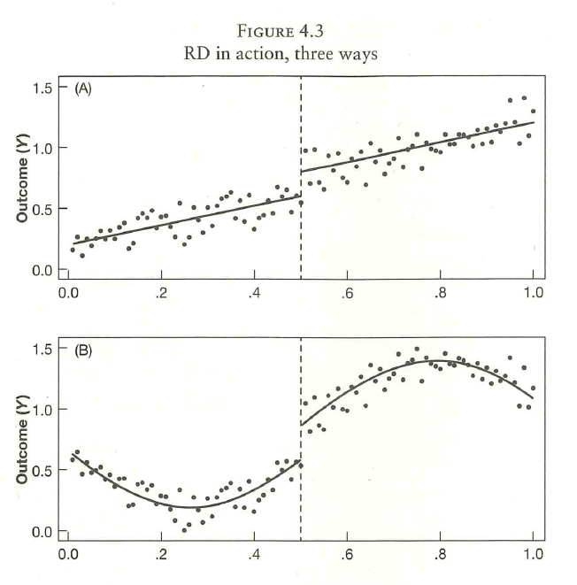
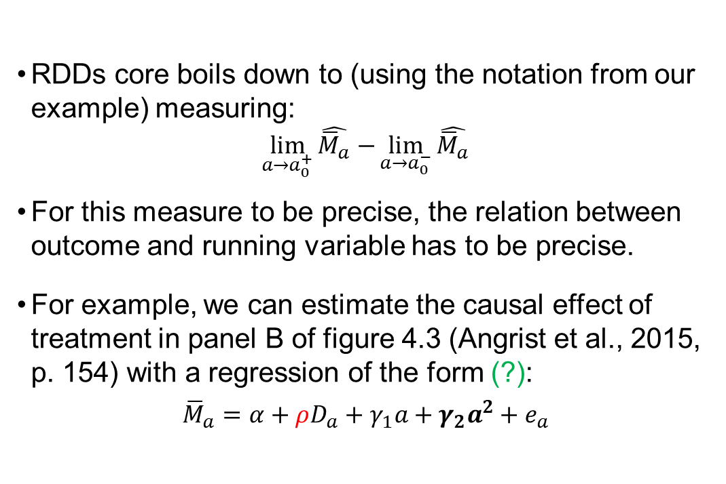
Birthdays and Funerals
RD Formalization: Non-linear trends
RDDs core boils down to (using the notation from our example) measuring:
$$\lim_{a→a_{0}^{+}}{\hat{{\overline{M}}_{a}}−}\lim_{a→a_{0}^{−}}{\hat{{\overline{M}}_{a}}}$$
For this measure to be precise, the relation between outcome and running variable has to be precise.
For example, we can estimate the causal effect of treatment in panel B of figure 4.3 (Angrist et al., 2015, p. 154) with a regression of the form (?):
$${\overline{M}}_{a}=α+ρD_{a}+γ_{1}a+γ_{2}a^{2}+e_{a}$$
Angrist & Pischke (2015)

Slide 15
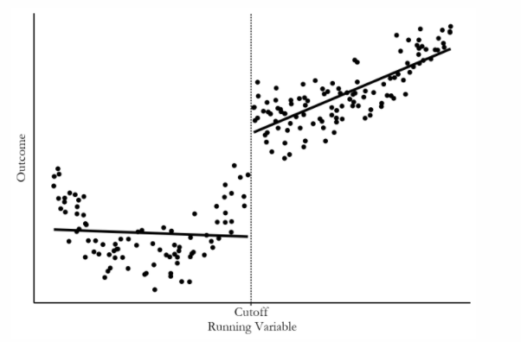
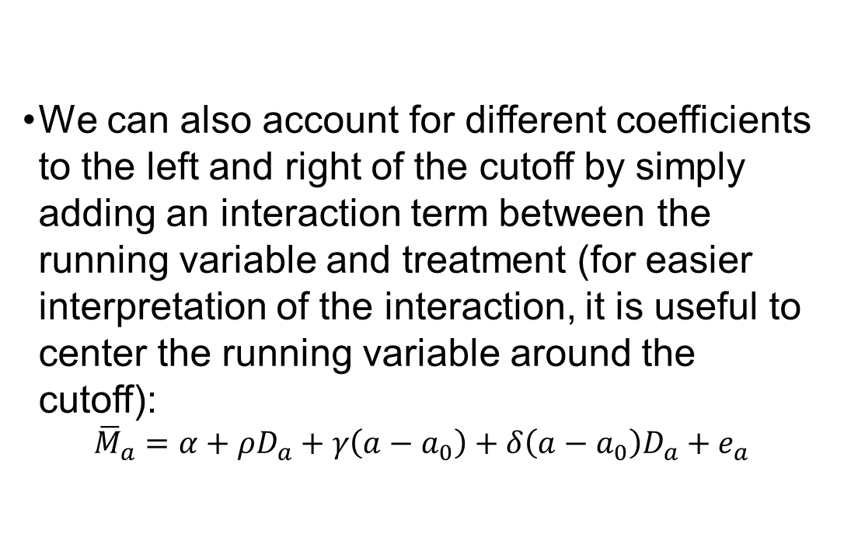
Birthdays and Funerals
RD Formalization: Interactions between treatment and running variables
We can also account for different coefficients to the left and right of the cutoff by simply adding an interaction term between the running variable and treatment (for easier interpretation of the interaction, it is useful to center the running variable around the cutoff):
$${\overline{M}}_{a}=α+ρD_{a}+γ\left(a−a_{0}\right)+δ\left(a−a_{0}\right)D_{a}+e_{a}$$
Figure 20.5 from Huntington (2022)
Angrist & Pischke (2015)

Slide 16
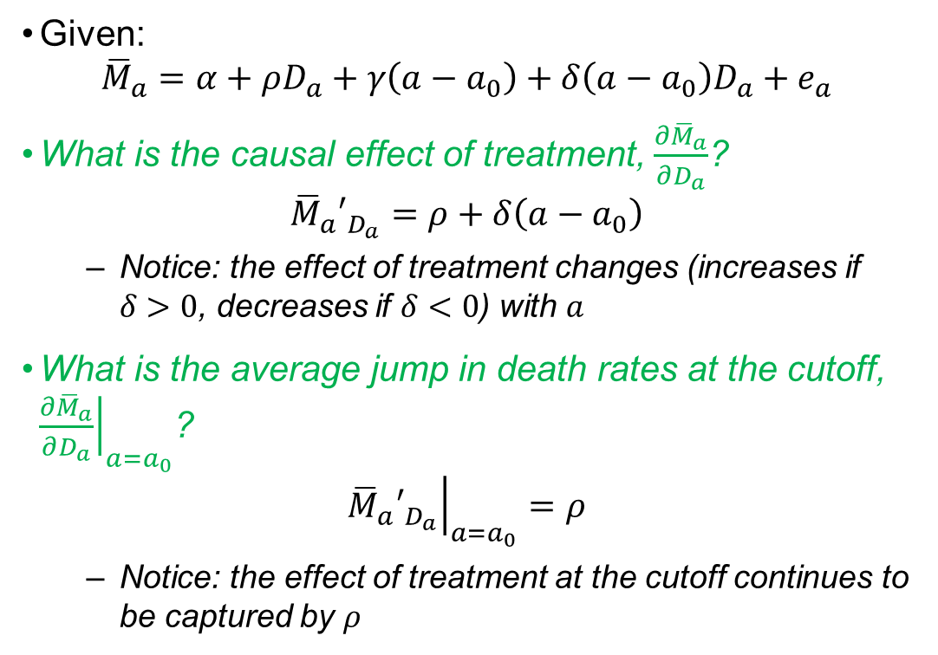
Birthdays and Funerals
RD Formalization: Interactions between treatment and running variables
Given:
$${\overline{M}}_{a}=α+ρD_{a}+γ\left(a−a_{0}\right)+δ\left(a−a_{0}\right)D_{a}+e_{a}$$
What is the causal effect of treatment, $\frac{∂{\overline{M}}_{a}}{∂D_{a}}$?
$${{\overline{M}}_{a}′}_{D_{a}}=ρ+δ\left(a−a_{0}\right)$$
Notice: the effect of treatment changes (increases if $δ>0$, decreases if $δ<0$) with $a$
What is the average jump in death rates at the cutoff, ${\left.\frac{∂{\overline{M}}_{a}}{∂D_{a}}\right|}_{a=a_{0}}$?
$${\left.{{\overline{M}}_{a}′}_{D_{a}}\right|}_{a=a_{0}}=ρ$$
Notice: the effect of treatment at the cutoff continues to be captured by $ρ$
Figure 20.5 from Huntington (2022)

Slide 17
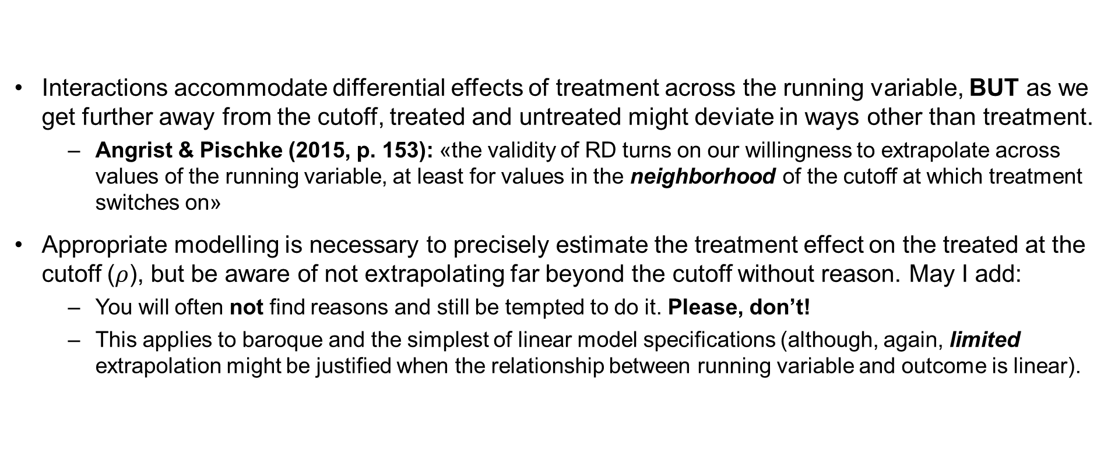
WARNING
Interactions accommodate differential effects of treatment across the running variable, BUT as we get further away from the cutoff, treated and untreated might deviate in ways other than treatment.
Angrist & Pischke (2015, p. 153): «the validity of RD turns on our willingness to extrapolate across values of the running variable, at least for values in the neighborhood of the cutoff at which treatment switches on»
Appropriate modelling is necessary to precisely estimate the treatment effect on the treated at the cutoff ($ρ$), but be aware of not extrapolating far beyond the cutoff without reason. May I add:
You will often not find reasons and still be tempted to do it. Please, don’t!
This applies to baroque and the simplest of linear model specifications (although, again, limited extrapolation might be justified when the relationship between running variable and outcome is linear).

Slide 18
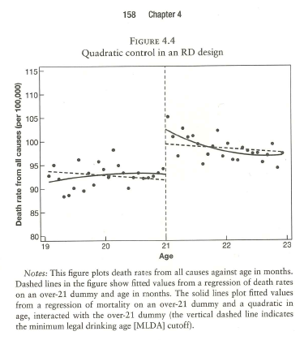
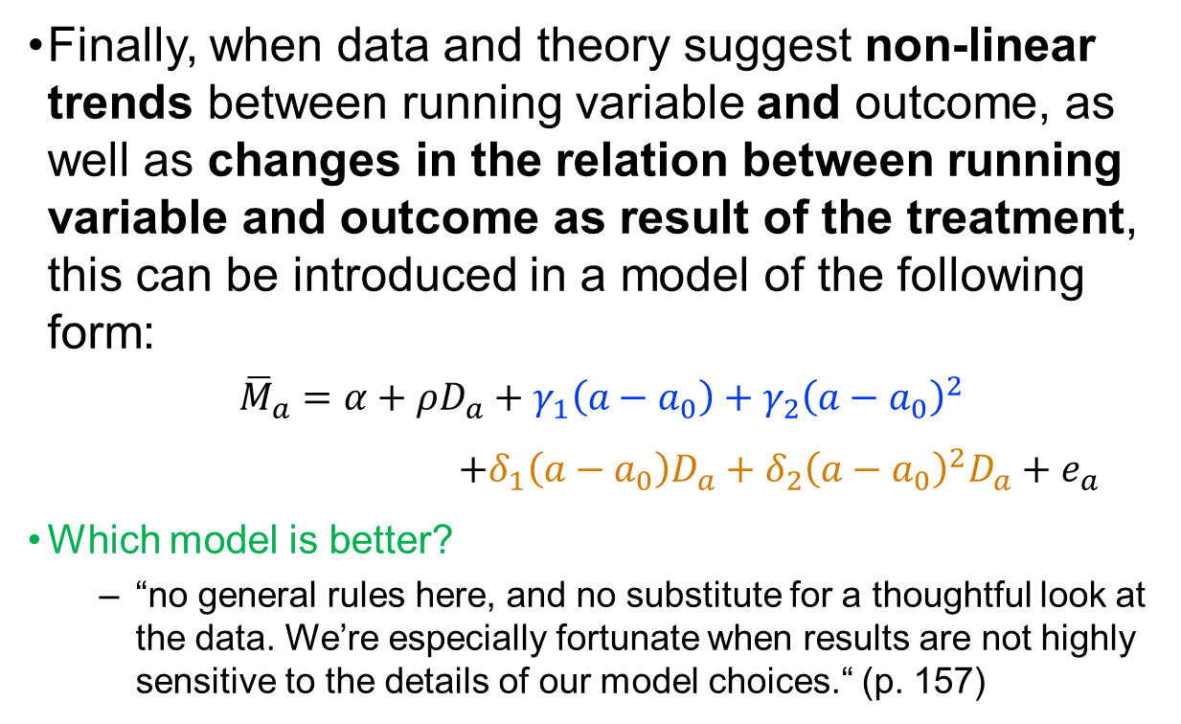
Birthdays and Funerals
RD Formalization: Non-linear trends & interaction terms
Finally, when data and theory suggest non-linear trends between running variable and outcome, as well as changes in the relation between running variable and outcome as result of the treatment, this can be introduced in a model of the following form:
$${\overline{M}}_{a}=α+ρD_{a}+γ_{1}\left(a−a_{0}\right)+γ_{2}{\left(a−a_{0}\right)}^{2}$$ $+δ_{1}\left(a−a_{0}\right)D_{a}+δ_{2}{\left(a−a_{0}\right)}^{2}D_{a}+e_{a}$
Which model is better?
“no general rules here, and no substitute for a thoughtful look at the data. We’re especially fortunate when results are not highly sensitive to the details of our model choices.“ (p. 157)
Angrist & Pischke (2015)

Slide 19
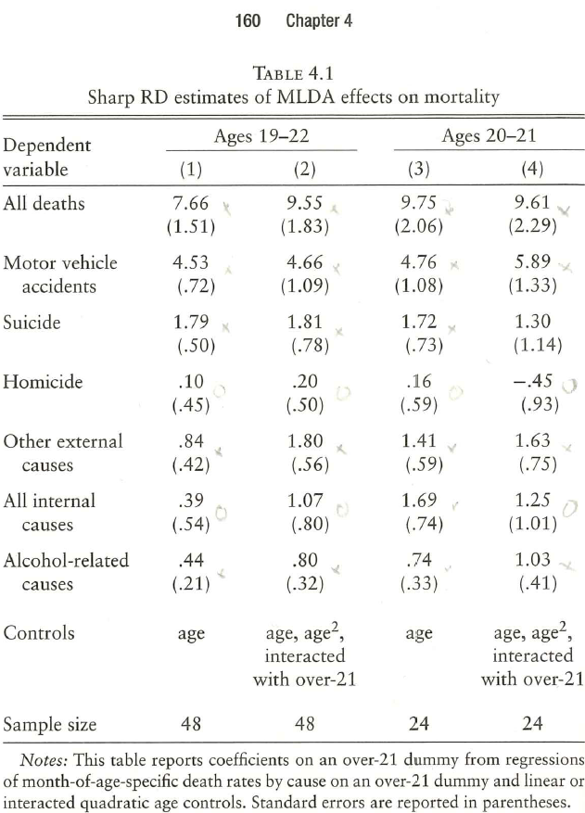
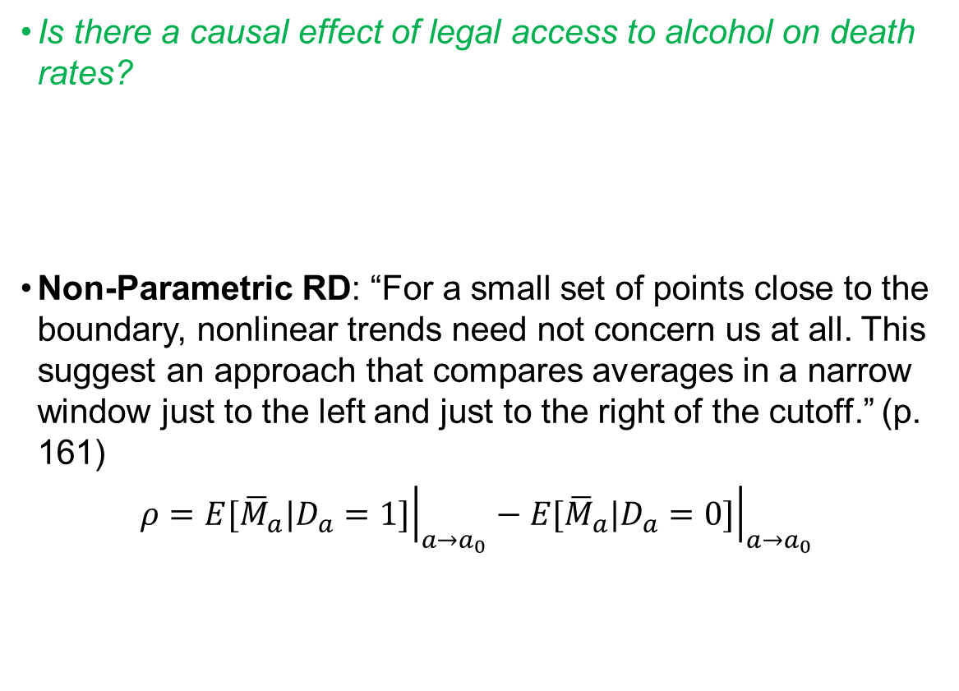
Birthdays and Funerals
Is there a causal effect of legal access to alcohol on death rates?
Non-Parametric RD: “For a small set of points close to the boundary, nonlinear trends need not concern us at all. This suggest an approach that compares averages in a narrow window just to the left and just to the right of the cutoff.” (p. 161)
$$ρ={\left.E[{\overline{M}}_{a}|D_{a}=1]\right|}_{a→a_{0}}−{\left.E[{\overline{M}}_{a}|D_{a}=0]\right|}_{a→a_{0}}$$
RD strategies: Regression vs. Non-Parametric RD
Angrist & Pischke (2015)

Slide 20
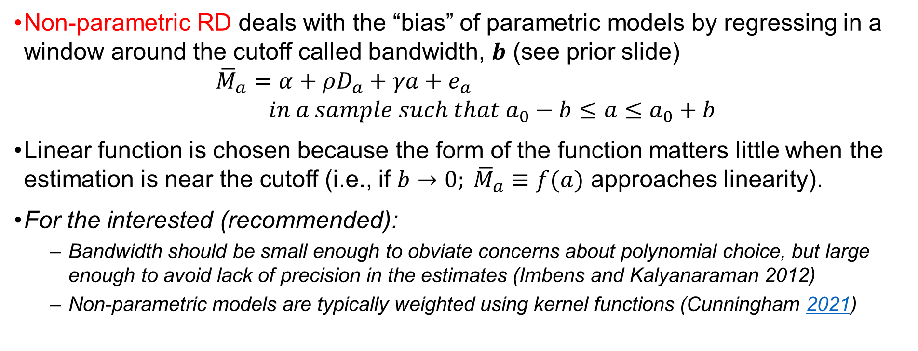
Birthdays and Funerals
RD strategies: Parametric RD vs. Non-Parametric RD
Non-parametric RD deals with the “bias” of parametric models by regressing in a window around the cutoff called bandwidth, $b$ (see prior slide)
$${\overline{M}}_{a}=α+ρD_{a}+γa+e_{a} \\ in a sample such that a_{0}−b≤a≤a_{0}+b$$
Linear function is chosen because the form of the function matters little when the estimation is near the cutoff (i.e., if $b→0; {\overline{M}}_{a}≡f(a)$ approaches linearity).
For the interested (recommended):
Bandwidth should be small enough to obviate concerns about polynomial choice, but large enough to avoid lack of precision in the estimates (Imbens and Kalyanaraman 2012)
Non-parametric models are typically weighted using kernel functions (Cunningham 2021)

Slide 21
GROUP EXCERCISE
Get together and try to come up with possible RD designs (real or imaginary). What are the running variable, cutoff, treatment and outcomes in your RD design?
Find inspiration in the examples we have seen until now:
MLDA on mortality rates (age, MLDA, access to alcohol, death rates)
Punishment on recidivism (BAC, punishable levels of alcohol, fine/jail, recidivism)
School attendance district boundaries on house prices (location, district boundaries, house prices, demand on houses)

Slide 22
The Elite Illusion
Setting the stage
Fuzzy RD
Exam schools: highly selective (on the basis of ISEE tests) public schools
RQ: consequences of exam school treatment
Hypothesis: exam schools have a positive effect on academic achievement driven by peer-effects
Problem: High-achievers will be high-achievers
Why does RCTs do not work here to answer the causal question?
If admission is randomized, peer-effects disappear and, thus, so does the potential causal effect
Applicants with scores close to admissions cutoff, whether to the right or to the left, might be considered as good as randomly assigned.
Nuance: at the cutoff, some students choose to go elsewhere while many of those rejected at one exam school end up at another (with a slightly lower cutoff slightly lower).
“When discontinuities change treatment probabilities or average characteristics (treatment intensity, for short), […] the resulting RD design is said to be fuzzy.” (pp. 165-166)
Angrist & Pischke (2015)
Notes:
ISEE: Independent Schools Entrance Exam

Slide 23
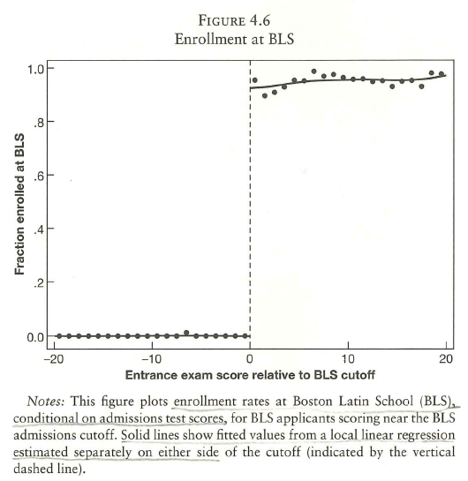
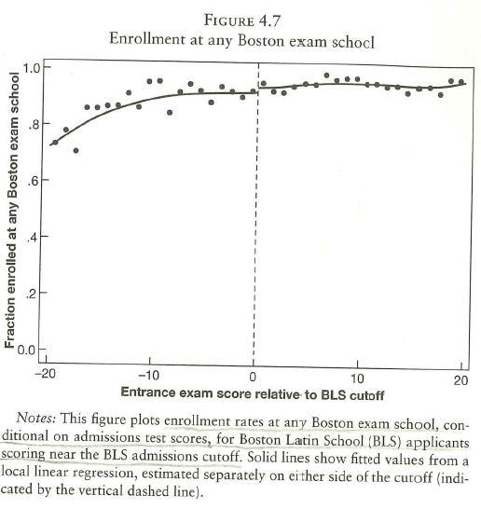
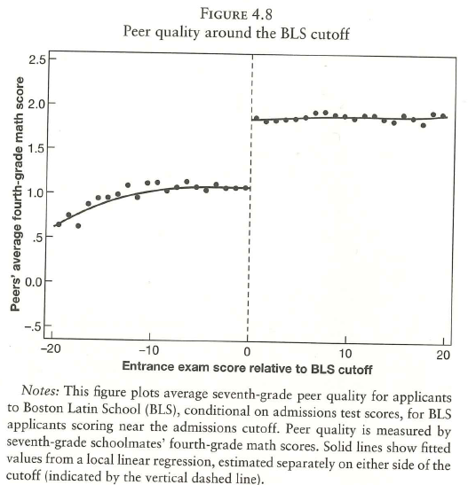
The Elite Illusion
Fuzzy RD
Angrist & Pischke (2015)
Notes:
Say that treatment is attendance to exam school ; running variable is entrance exam score, and let’s stablish the cutoff for enrollment on BLS, the most prestigious of exam schools, as the cutoff of our RD design
In sharp RD, probability or intensity of treatment changes from 0 to 1 at the cutoff. However, if we plot treatment on running variable, we see almost no discontinuation.
This does not mean that we have to settle to compare highly selective BLS effect to somewhat less selective exam schools instead of the most interesting evaluation of exam school
In the prior slide, we stablished the hypothesis that peer effects might be the driving force of exam schools potential benefits
if we look at the last graph, the cut off, peer’s average 4th grade math score at both sides of the cutoff change by .8 SD. A notable difference. If we using peer effects as treatment, we would have that at the cut off, the treatment intensity varies by .8 SD. Such dramatic difference variance in treatment intensity lies at the heart of any fuzzy RD research design.
THE DIFFERENCE BETWEEN FUZZY AND SHARP DESIGNS IS THAT, WITH FUZZY, APPLICANTS WHO CROSS A THRESHOLD ARE EXPOSED TO A MORE INTENSE TREAT,EMT, WHILE IN A SHARP DESIGN TREATMENT SWITCHES CLEANLY ON OR OFF AT THE CUT OFF.

Slide 24
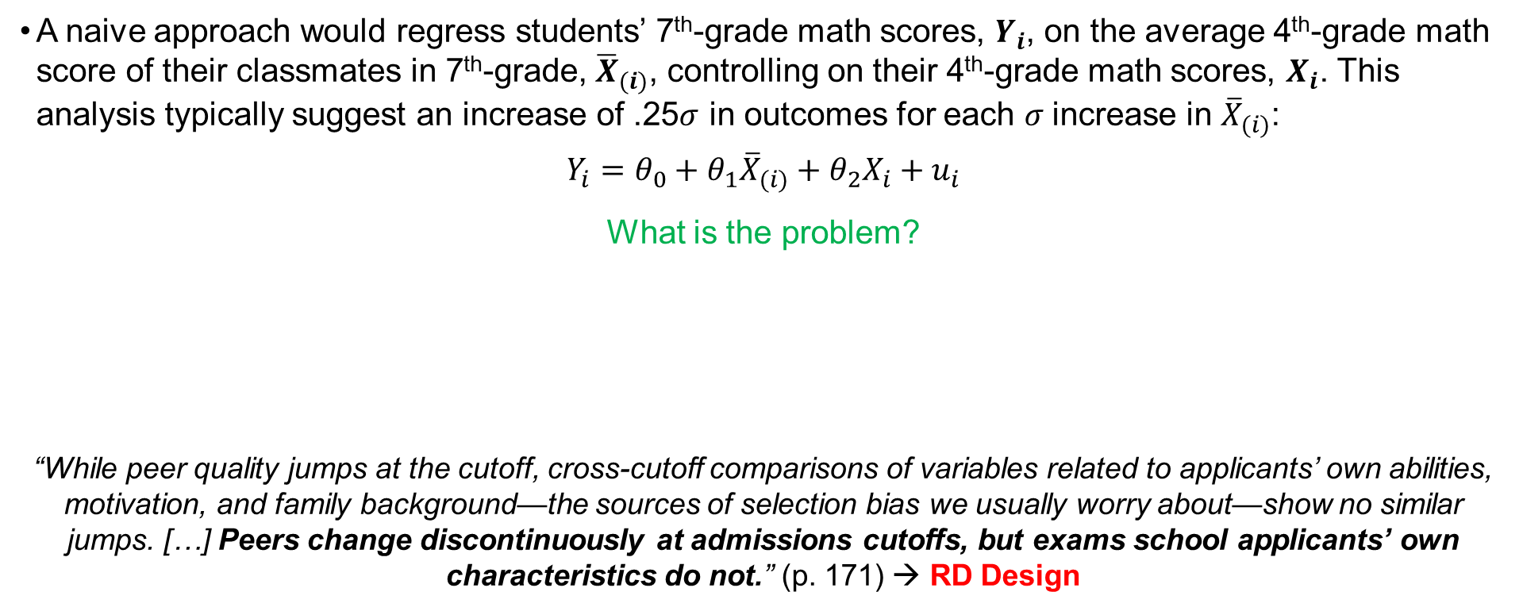
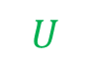
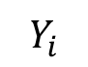
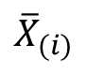
The Elite Illusion
Fuzzy RD Is IV
A naive approach would regress students’ 7th-grade math scores, $Y_{i}$, on the average 4th-grade math score of their classmates in 7th-grade, ${\overline{X}}_{(i)}$, controlling on their 4th-grade math scores, $X_{i}$. This analysis typically suggest an increase of .25$σ$ in outcomes for each $σ$increase in ${\overline{X}}_{(i)}$:
$$Y_{i}=θ_{0}+θ_{1}{\overline{X}}_{(i)}+θ_{2}X_{i}+u_{i}$$
What is the problem?
“While peer quality jumps at the cutoff, cross-cutoff comparisons of variables related to applicants’ own abilities, motivation, and family background—the sources of selection bias we usually worry about—show no similar jumps. […] Peers change discontinuously at admissions cutoffs, but exams school applicants’ own characteristics do not.” (p. 171) → RD Design
$${\overline{X}}_{(i)}$$
$$Y_{i}$$
$$U$$
Angrist & Pischke (2015)
Notes:
Students educated together tend to be similar for may reasons. E.g., because family background is not held fixed in naive regressions, the observed association between studetns and their classmates undoubtedly reflects some shared influences. To break the causal deadlock, we would like to randomly assign students to a range of different peer groups.

Slide 25
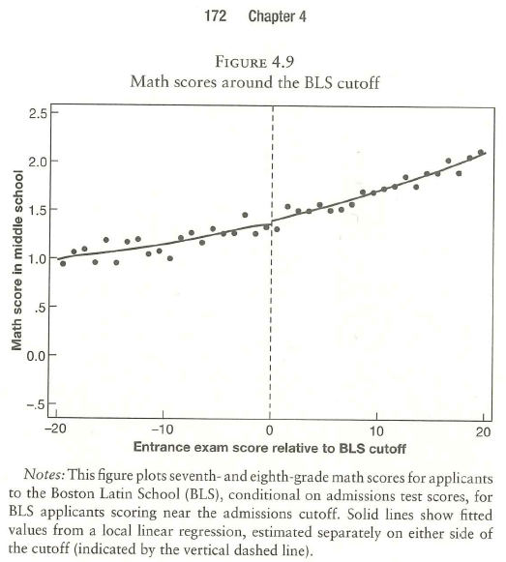
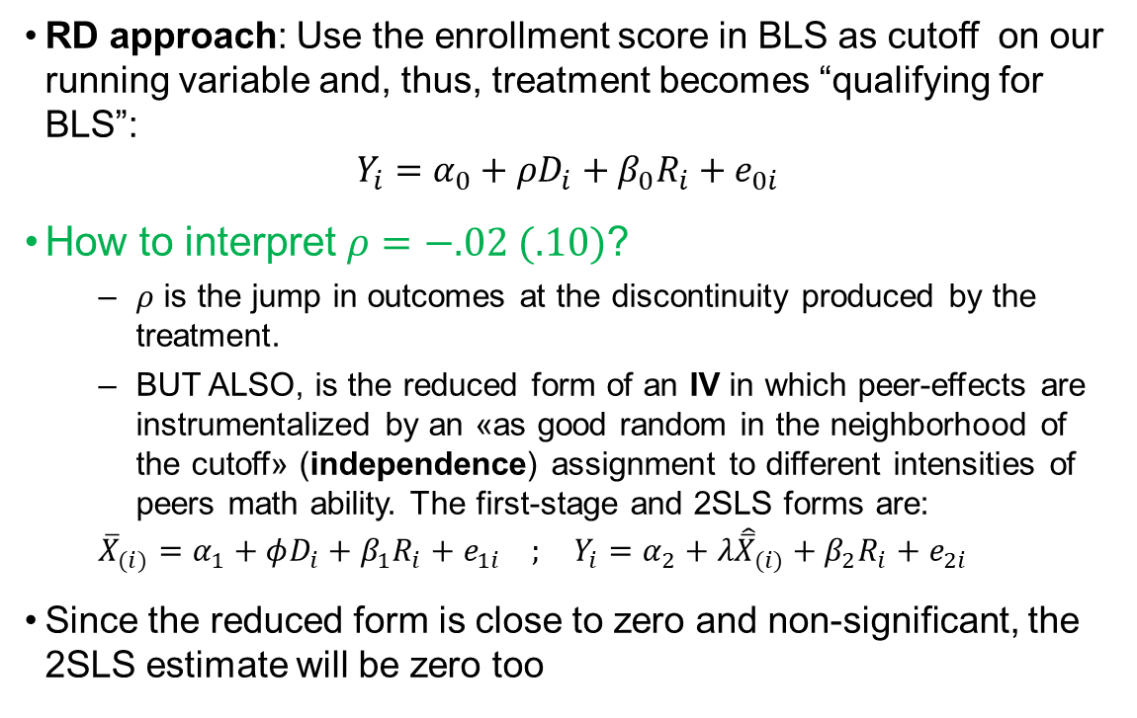
The Elite Illusion
Fuzzy RD Is IV
RD approach: Use the enrollment score in BLS as cutoff on our running variable and, thus, treatment becomes “qualifying for BLS”:
$$Y_{i}=α_{0}+ρD_{i}+β_{0}R_{i}+e_{0i}$$
How to interpret $ρ=−.02 (.10)$?
$ρ$ is the jump in outcomes at the discontinuity produced by the treatment.
BUT ALSO, is the reduced form of an IV in which peer-effects are instrumentalized by an «as good random in the neighborhood of the cutoff» (independence) assignment to different intensities of peers math ability. The first-stage and 2SLS forms are:
$${\overline{X}}_{(i)}=α_{1}+φD_{i}+β_{1}R_{i}+e_{1i} ; Y_{i}=α_{2}+λ{\hat{\overline{X}}}_{(i)}+β_{2}R_{i}+e_{2i}$$
Since the reduced form is close to zero and non-significant, the 2SLS estimate will be zero too
Angrist & Pischke (2015)

Slide 26
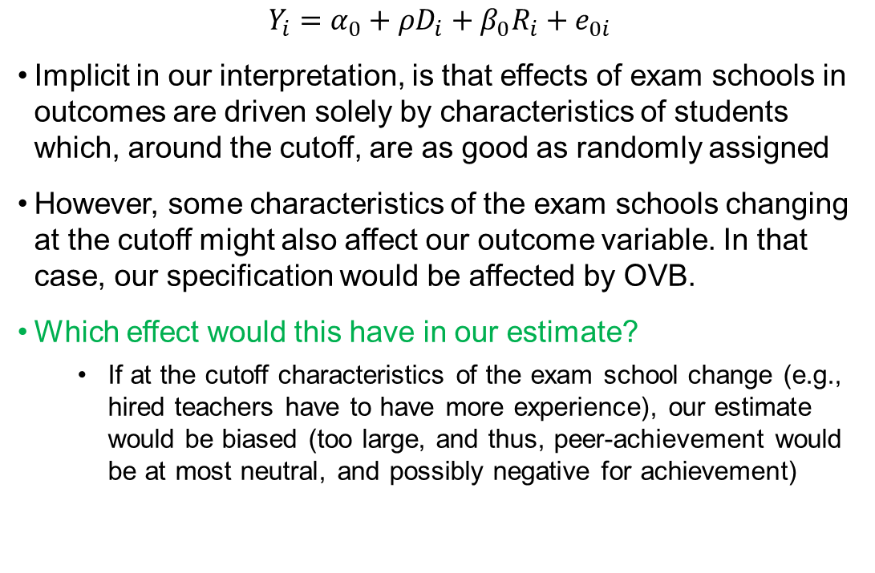
The Elite Illusion
More interpretation
$$Y_{i}=α_{0}+ρD_{i}+β_{0}R_{i}+e_{0i}$$
Implicit in our interpretation, is that effects of exam schools in outcomes are driven solely by characteristics of students which, around the cutoff, are as good as randomly assigned
However, some characteristics of the exam schools changing at the cutoff might also affect our outcome variable. In that case, our specification would be affected by OVB.
Which effect would this have in our estimate?
If at the cutoff characteristics of the exam school change (e.g., hired teachers have to have more experience), our estimate would be biased (too large, and thus, peer-achievement would be at most neutral, and possibly negative for achievement)
Angrist & Pischke (2015)

Slide 27
Take away messages
RDD take advantage of more or less arbitrary cutoffs in running variables to, under the assumption that near the cutoff individuals average characteristics are equal, infer causal effects of treatment
Sharp RDDs allow causal inference when treatment switches at the cutoff.
Fuzzy RDDs allow causal inference when treatment probability or intensity changes at the cutoff.
Fuzzy RDDs are methodologically equivalent to IV

Slide 28
9 | Regression Discontinuity II Time: 13 September 2022, 12:15-14:00h Main instructor: Tony Tan Required reading: Steinman & Olsen (2002)
10 | Differences-in-Differences I Time: 16 September 2022, 10:15-12:00h Main instructor: José Manuel Arencibia Alemán Required reading: Angrist & Pischke (2015), chapter 5
11 | Differences-in-Differences II Time: 20 September 2022, 12:15-14:00h Main instructor: Tony Tan Required reading: Strello, Strietholdt, Steinmann & Siepmann (2021)
12 | Lessons Learned Time: 23 September 2022, 10:15-12:00h Main instructor: José Manuel Arencibia Alemán Required reading: Rutkowski & Delandshere (2016)

Slide 29
Recommended Literature
Cunningham, S. (2021). Causal inference : the mixtape. New Haven, Connecticut, Yale University Press. (Chapter 6)
N. Huntington-Klein (2022). The effect : an introduction to research design and causality. Boca Raton, Chapman and Hall/CRC Press. (Chapter 20)
Angrist, J. D. and J.-S. Pischke (2008). Mostly Harmless Econometrics : An Empiricist's Companion. Princeton, NJ, Princeton University Press. (Chapter 6, available online at through the University Library)

Slide 30
References
Main reference:
Angrist, J. D. and J.-S. Pischke (2015). Mastering 'metrics : the path from cause to effect. Princeton, N.J, Princeton University Press.
Other sources:
Cunningham, S. (2021). Causal inference : the mixtape. New Haven, Connecticut, Yale University Press.
Huntington-Klein, N. and N. Huntington-Klein (2022). The effect : an introduction to research design and causality. Boca Raton, Chapman and Hall/CRC Press.
Example papers:
Black, S. E. (1999). "Do Better Schools Matter? Parental Valuation of Elementary Education." The Quarterly Journal of Economics 114(2): 577-599.
Hansen, B. (2015). "Punishment and Deterrence: Evidence from Drunk Driving." American Economic Review 105(4): 1581-1617.

